Slide 1


Chin Kar Kit
12nd October 2024

Slide 2

Outline
Executive Summary
Introduction
Methodology
Results
Conclusion
Appendix

Slide 3
Executive Summary
Summary of methodologies
Data Collection through API
Data Collection with Web Scraping
Data Wrangling
Exploratory Data Analysis with SQL
Exploratory Data Analysis with Data Visualization
Interactive Visual Analytics with Folium
Machine Learning Prediction
Summary of all results
Exploratory Data Analysis result
Interactive analytics in screenshots
Predictive Analytics result

Slide 4
Introduction
Project background and context
SpaceX promotes Falcon 9 rocket launches on its website at a price of $62 million, while other providers charge upwards of $165 million per launch. Much of the cost savings comes from SpaceX’s ability to reuse the first stage. Thus, if we can predict whether the first stage will successfully land, we can estimate the launch cost. This information can be useful for competing companies looking to bid against SpaceX for rocket launches. The project's objective is to build a machine learning pipeline that can predict the success of the first stage landing.
Problems you want to find answers
What factors influence the rocket's ability to land successfully?
The success rate of a landing is determined by the interaction of multiple features.
What operational conditions must be met to ensure a successful landing program?

Slide 5


Slide 6
Methodology
Executive Summary
Data collection methodology:
The data was gathered through the SpaceX API and web scraping from Wikipedia.
Perform data wrangling
One-hot encoding was used to transform the categorical features.
Perform exploratory data analysis (EDA) using visualization and SQL
Perform interactive visual analytics using Folium and Plotly Dash
Perform predictive analysis using classification models
How to build, tune, evaluate classification models

Slide 7
Data Collection
The data was collected using various methods
Data was collected by sending a GET request to the SpaceX API.
The response content was decoded into JSON format using the `.json()` function, and then converted into a pandas DataFrame with `.json_normalize()`.
Afterward, we cleaned the data, checked for missing values, and filled them in where necessary.
Additionally, web scraping was performed on Wikipedia to gather Falcon 9 launch records using BeautifulSoup.
The goal was to extract the launch records from an HTML table, parse it, and convert it into a pandas DataFrame for future analysis.

Slide 8
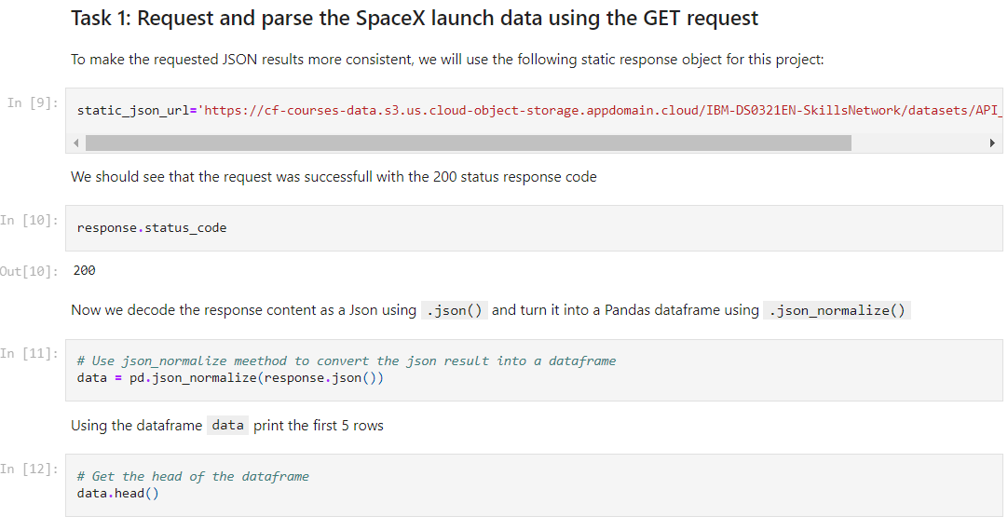
Data Collection – SpaceX API
We used a GET request to the SpaceX API to collect data, then cleaned the retrieved data and performed basic data wrangling and formatting.
The link to the notebook is https://github.com/KarKit2001/Applied-Data-Science-Capstone/blob/main/1%20Hands-on%20Lab%20Complete%20the%20Data%20Collection%20API%20Lab.ipynb

Slide 9
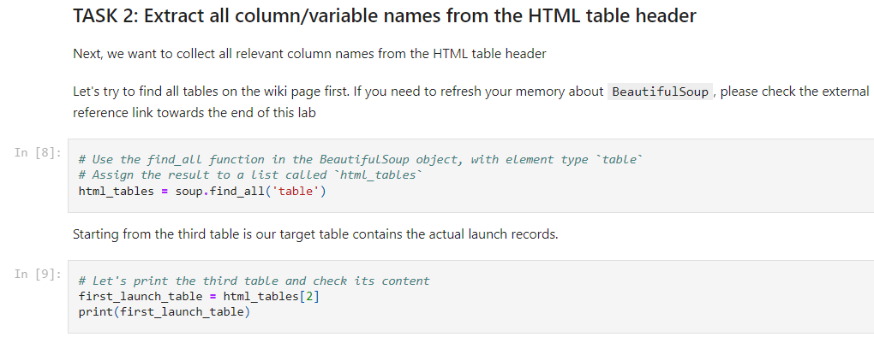
Data Collection - Scraping
We used web scraping with BeautifulSoup to collect Falcon 9 launch records.
The table was parsed and converted into a pandas DataFrame for further analysis.
The link to the notebook is https://github.com/KarKit2001/Applied-Data-Science-Capstone/blob/main/2%20Hands-on%20Lab%20Data%20Collection%20with%20Web%20Scraping.ipynb

Slide 10

Data Wrangling
We conducted exploratory data analysis to identify the training labels.
We calculated the number of launches at each site and analyzed the frequency and distribution of different orbits.
We also generated a landing outcome label based on the outcome column and exported the results to a CSV file.
The link to the notebook is https://github.com/KarKit2001/Applied-Data-Science-Capstone/blob/main/3%20Hands-on%20Lab%20Data%20Wrangling.ipynb

Slide 11
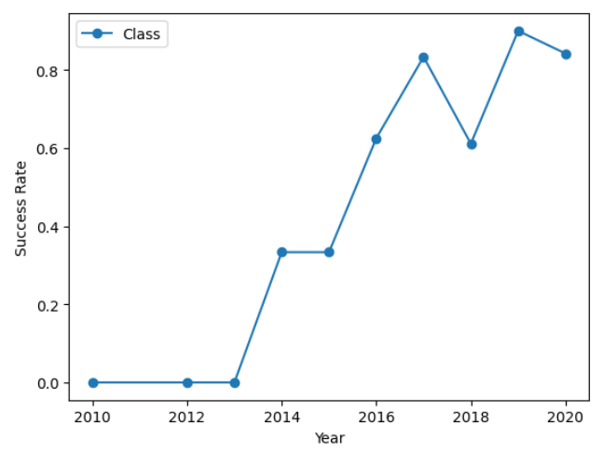
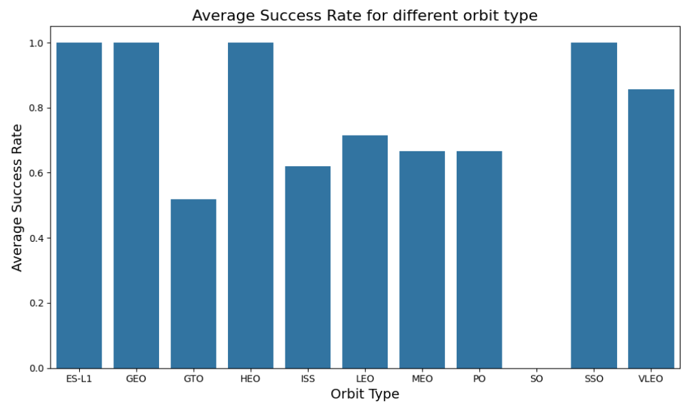
EDA with Data Visualization
We explored the data by visualizing various relationships, including flight number and launch site, payload and launch site, the success rate of each orbit type, flight number and orbit type, and the yearly trend of launch success.
The link to the notebook is https://github.com/KarKit2001/Applied-Data-Science-Capstone/blob/main/5%20EDA%20with%20Visualization%20Lab.ipynb

Slide 12
EDA with SQL
We loaded the SpaceX dataset into a PostgreSQL database directly within the Jupyter notebook.
Then, we performed exploratory data analysis (EDA) using SQL to gain insights. We wrote queries to answer questions such as:
The names of unique launch sites in the space mission.
The total payload mass carried by boosters launched by NASA (CRS)
The average payload mass carried by booster version F9 v1.1
The total number of successful and failure mission outcomes
The failed landing outcomes in drone ship, their booster version and launch site names.
The link to the notebook is https://github.com/KarKit2001/Applied-Data-Science-Capstone/blob/main/4%20Hands-on%20Lab%20Complete%20the%20EDA%20with%20SQL.ipynb

Slide 13
Build an Interactive Map with Folium
We marked all launch sites and added map elements such as markers, circles, and lines to indicate the success or failure of launches at each site on the Folium map.
We classified the launch outcomes, assigning class 0 for failure and class 1 for success. By using color-coded marker clusters, we identified launch sites with relatively high success rates.
We marked all launch sites, and added map objects such as markers, circles, lines to mark the success or failure of launches for each site on the folium map.
Additionally, we calculated the distances between launch sites and their proximities. We addressed questions such as:
Are launch sites near railways, highways and coastlines.
Do launch sites keep certain distance away from cities.

Slide 14
Build a Dashboard with Plotly Dash
We created an interactive dashboard using Plotly Dash.
The dashboard features pie charts displaying the total number of launches by specific sites and a scatter plot illustrating the relationship between launch outcomes and payload mass (in kg) for different booster versions.
The link to the notebook is https://github.com/KarKit2001/Applied-Data-Science-Capstone/blob/main/7%20Hands-on%20Lab%20Build%20an%20Interactive%20Dashboard%20with%20Ploty%20Dash.txt

Slide 15
Predictive Analysis (Classification)
We loaded the data using numpy and pandas, transformed the data, split our data into training and testing.
We built different machine learning models and tune different hyperparameters using GridSearchCV.
We used accuracy as the metric for our model, improved the model using feature engineering and algorithm tuning.
We found the best performing classification model.
The link to the notebook is https://github.com/KarKit2001/Applied-Data-Science-Capstone/blob/main/8%20Hands-on%20Lab%20Complete%20the%20Machine%20Learning%20Prediction%20lab.ipynb

Slide 16
Results
Exploratory data analysis results
Interactive analytics demo in screenshots
Predictive analysis results

Slide 17


Slide 18

Flight Number vs. Launch Site
From the plot, we observed that a higher number of flights at a launch site is associated with a greater success rate.

Slide 19


Payload vs. Launch Site

Slide 20
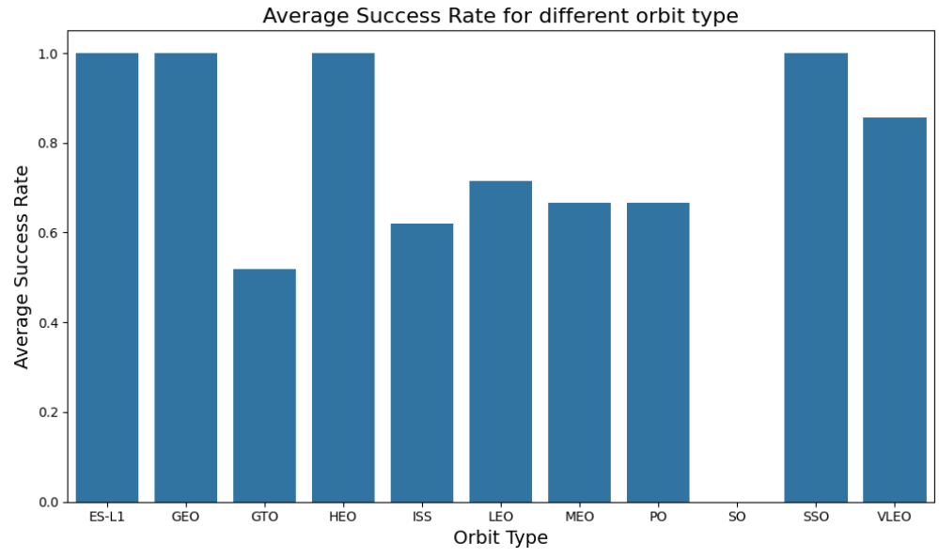
Success Rate vs. Orbit Type
The plot shows that ES-L1, GEO, HEO, SSO, and VLEO had the highest success rates.

Slide 21

Flight Number vs. Orbit Type
The plot below illustrates the relationship between flight number and orbit type. We observe that for the LEO orbit, success is correlated with the number of flights, while for the GTO orbit, there appears to be no relationship between flight number and success.

Slide 22

Payload vs. Orbit Type
We can see that heavier payloads are associated with a higher rate of successful landings for the PO, LEO, and ISS orbits.

Slide 23
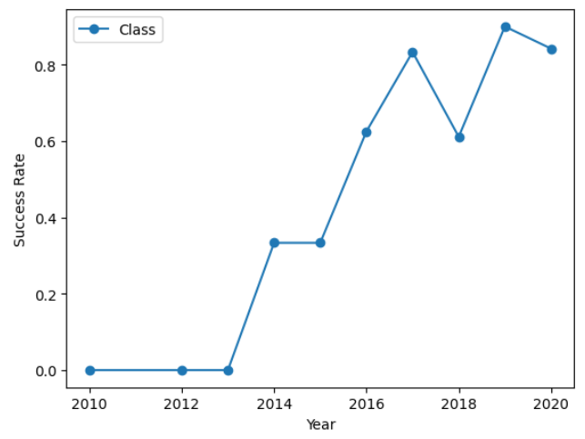
Launch Success Yearly Trend
The plot indicates that the success rate has consistently increased from 2013 until 2020.

Slide 24

All Launch Site Names
We utilized the keyword DISTINCT to display only the unique launch sites from the SpaceX data.

Slide 25

Launch Site Names Begin with 'CCA'
We used the query above to retrieve 5 records where the launch sites start with `CCA`.

Slide 26

Total Payload Mass
We calculated the total payload carried by boosters from NASA as 45,596 using the query below.

Slide 27

Average Payload Mass by F9 v1.1
We calculated the average payload mass carried by booster version F9 v1.1 to be 2,928.4.

Slide 28

First Successful Ground Landing Date
We noted that the first successful landing outcome on a ground pad occurred on December 22, 2015.

Slide 29

Successful Drone Ship Landing with Payload between 4000 and 6000
We used the WHERE clause to filter for boosters that successfully landed on a drone ship and applied the AND condition to identify successful landings with a payload mass greater than 4,000 but less than 6,000.

Slide 30

Total Number of Successful and Failure Mission Outcomes
We used the wildcard character `%` to filter for records where the MissionOutcome was either a success or a failure.

Slide 31

Boosters Carried Maximum Payload
We identified the booster that carried the maximum payload by using a subquery in the WHERE clause along with the MAX() function.

Slide 32

2015 Launch Records
We used a combination of the WHERE clause, LIKE, AND, and BETWEEN conditions to filter for failed landing outcomes on drone ships, along with their booster versions and launch site names for the year 2015.

Slide 33

Rank Landing Outcomes Between 2010-06-04 and 2017-03-20
We selected Landing outcomes and the COUNT of landing outcomes from the data and used the WHERE clause to filter for landing outcomes BETWEEN 2010-06-04 to 2010-03-20.
We applied the GROUP BY clause to group the landing outcomes and the ORDER BY clause to order the grouped landing outcome in descending order.

Slide 34


Slide 35

All launch sites global map markers

Slide 36

Markers showing launch sites with color labels

Slide 37

Launch Site distance to landmarks

Slide 38


Slide 39

Pie chart showing the success percentage achieved by each launch site

Slide 40

Pie chart showing the Launch site with the highest launch success ratio

Slide 41

Scatter plot of Payload vs Launch Outcome for all sites, with different payload selected in the range slider

Slide 42


Slide 43

Classification Accuracy
The decision tree classifier achieved the highest classification accuracy among the models.

Slide 44

Confusion Matrix
The confusion matrix for the decision tree classifier indicates that it can effectively distinguish between different classes. However, a significant issue is the occurrence of false positives, where unsuccessful landings are incorrectly classified as successful.

Slide 45
Conclusions
We can conclude that:
A higher number of flights at a launch site correlates with a greater success rate.
The launch success rate began to increase from 2013 to 2020.
The orbits ES-L1, GEO, HEO, SSO, and VLEO achieved the highest success rates.
KSC LC-39A recorded the most successful launches among all sites.
The decision tree classifier is the most effective machine learning algorithm for this task.

Slide 46


